Slide 1
Design Science in Information Systems Research
Kiyan Rezaee – 8 July 2022

Slide 2
What is IS?
information system, an integrated set of components for collecting, storing, and processing data and for providing information, knowledge, and digital products.
Personal computers, smartphones, databases, and networks are just some examples of information systems.

Slide 3
Design Science
IS
behavioral Science

Slide 4
Behavioral Science
The behavioral-science paradigm seeks to develop and verify theories that explain or predict human or organizational behavior.
Examples of behavioral sciences include psychology, psychobiology, anthropology, and cognitive science.

Slide 5
Design Science
The design-science paradigm seeks to extend the boundaries of human and organizational capabilities by creating new and innovative artifacts.
A general understanding of artifact in Design Science Research is that it is an object made by humans with the intention that it is used to address a practical problem.
Both paradigms are foundational to the IS discipline, positioned as it is at the confluence of people, organizations, and technology.

Slide 6
Introduction
Information systems are implemented within an organization for the purpose of improving the effectiveness and efficiency of that organization.
We argue that acquiring such knowledge involves two complementary but distinct paradigms, behavioral science and design science.

Slide 7
Roots
B-S : The behavioral-science paradigm has its roots in natural science research methods. It seeks to develop and justify theories(i.e., principles and laws) that explain or predict organizational and human phenomena sur-rounding the analysis, design, implementation, management, and use of information systems.
D-S : The design-science paradigm has its roots in engineering and the sciences of the artificial (Simon 1996). It is fundamentally a problem-solving paradigm.

Slide 8
Such artifacts are not exempt from natural laws or behavioral theories. To the contrary, their creation relies on existing kernel theories that are applied, tested, modified, and extended through the experience, creativity, intuition, and problem solving capabilities of the researcher.
However, designing useful artifacts is complex due to the need for creative advances in domain areas in which existing theory is often insufficient.

Slide 9
IT artifacts?
The resultant IT artifacts extend the boundaries of human problem solving and organizational capabilities by providing intellectual as well as computational tools. Theories regarding their application and impact will follow their development and use.
Bundles of hardware infrastructure, software applications, informational content, and supporting resources that serve specific goals and needs in personal or organizational contexts.

Slide 10
IT artifacts?
IT artifacts are broadly defined as constructs (vocabulary and symbols),models (abstractions and representations),methods (algorithms and practices), and instantiations (implemented and prototype systems).

Slide 11
Primary goal
The primary goal of this paper is to inform the community of IS researchers and practitioners of how to conduct, evaluate, and present design-science research. We do so by describing the boundaries of design science within the IS discipline via a conceptual framework for understanding information systems research and by developing a set of guidelines for conducting and evaluating good design-science research.

Slide 12
A Framework for IS Research
To achieve a true understanding of and appreciation for design science as an IS research paradigm, an important dichotomy must be faced. Design is both a process (set of activities) and a product (artifact) verb and a noun (Walls et al.1992)

Slide 13
*The design process is a sequence of expert activities that produces an innovative product (i.e., the design artifact). The evaluation of the artifact then provides feedback information and a better understanding of the problem in order to improve both the quality of the product and the design process. This build-and-evaluate loop is typically iterated a number of times before the final design artifact is generated (Markus et al. 2002).

Slide 14
March and Smith (1995)
March and Smith (1995) identify two design processes and four design artifacts produced by design-science research in IS. The two processes are build and evaluate. The artifacts are constructs, models, methods, and instantiations.
Purposeful artifacts are built to address heretofore unsolved problems.

Slide 15
Constructs
Constructs provide the language in which problems and solutions are defined and communicated (Schˆn 1983).

Slide 16
Models
Models use constructs to represent a real world situation design problem and its solution space.

Slide 17
Methods
Methods define processes. They provide guidance on how to solve problems, that is, how to search the solution space. These can range from formal, mathematical algorithms that explicitly define the search process to informal, textual descriptions of best practice approaches, or some combination.

Slide 18
Instantiations
Instantiations show that constructs, models, or methods can be implemented in a working system. They demonstrate feasibility, enabling concrete assessment of an artifacts suitability to its intended purpose. They also enable researchers to learn about the real world, how the artifact affects it, and how users appropriate it.

Slide 19
Business need
Given such an articulated business need, IS research is conducted in two complementary phases. Behavioral science addresses research through the development and justification of theories that explain or predict phenomena related to the identified business need. Design science addresses research through the building and evaluation of artifacts designed to meet the identified business need.

Slide 20
Truth vs utility
The goal of behavioral-science research is truth. The goal of design-science research is utility. As argued above, our position is that truth and utility are inseparable. Truth informs design and utility informs theory.

Slide 21
Methodologies
The knowledge base provides the raw materials from and through which IS research is accomplished. The knowledge base is composed of foundations and methodologies.
Methodologies provide guidelines used in the justify/evaluate phase
In behavioral science, methodologies are typically rooted in data collection and empirical analysis techniques.
In design science, computational and mathematical methods are primarily used to evaluate the quality and effectiveness of artifacts; however, empirical techniques may also be employed.

Slide 22
Contributions
A justified theory that is not useful for the environment contributes as little to the IS literature as an artifact that solves a nonexistent problem.

Slide 23
Routine design vs design research
One issue that must be addressed in design-science research is differentiating routine design or system building from design research. The difference is in the nature of the problems and solutions. Routine design is the application of existing knowledge to organizational problems, such as constructing a financial or marketing information system using best practice artifacts (constructs, models, methods, and instantiations) existing in the knowledge base. On the other hand, design-science research addresses important unsolved problems in unique or innovative ways or solved problems in more effective or efficient ways. The key differentiator between routine design and design research is the clear identification of a contribution to the archival knowledge base of foundations and methodologies.

Slide 24
Wicked problems in D-S
unstable requirements and constraints based upon ill-defined environmental contexts
complex interactions among subcomponents of the problem and its solution
inherent flexibility to change design processes as well as design artifacts (i.e.,malleable processes and artifacts)
a critical dependence upon human cognitive abilities (e.g., creativity) to produce effective solutions
a critical dependence upon human social abilities (e.g., teamwork) to produce effective solutions

Slide 25
Guidelines for Design Science in Information Systems Research
As discussed above, design science is inherently a problem solving process. The fundamental principle of design-science research from which our seven guidelines are derived is that knowledge and understanding of a design problem and its solution are acquired in the building and application of an artifact. That is, design-science research requires the creation of an innovative, purposeful artifact (Guideline 1) for a specified problem domain (Guideline 2). Because the artifact is purposeful, it must yield utility for the specified problem. Hence, thorough evaluation of the artifact is crucial (Guideline 3). Novelty is similarly crucial since the artifact must be innovative, solving a heretofore unsolved problem or solving a known problem in a more effective or efficient manner (Guideline 4).

Slide 26
Continue…
In this way, design-science research is differentiated from the practice of design. The artifact itself must be rigorously defined, formally represented, coherent, and internally consistent (Guideline 5). The process by which it is created, and often the artifact itself, incorporates or enables a search process whereby a problem space is constructed and a mechanism posed or enacted to find an effective solution (Guideline 6). Finally, the results of the design-science research must be communicated effectively (Guideline 7) both to a technical audience (researchers who will extend them and practitioners who will implement them) and to a managerial audience (researchers who will study them in context and practitioners who will decide if they should be implemented within their organizations).

Slide 27
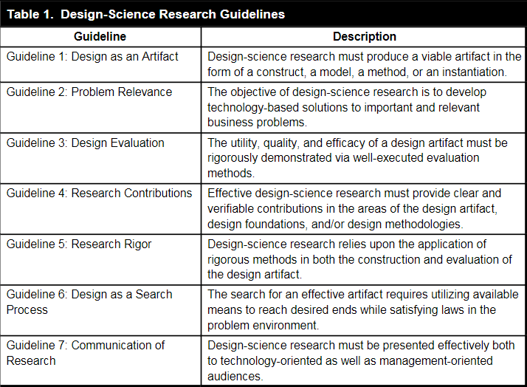

Slide 28
Design Evaluation
Evaluation is a crucial component of the research process.
The business environment establishes the requirements upon which the evaluation of the artifact is based.
As in the justification of a behavioral science theory, evaluation of a designed IT artifact requires the definition of appropriate metrics and possibly the gathering and analysis of appropriate data.

Slide 29
Design Evaluation
designed artifacts may be mathematically evaluated. As two examples, distributed database design algorithms can be evaluated using expected operating cost or average response time for a given characterization of information processing requirements (Johansson et al. 2003) and search algorithms can be evaluated using information retrieval metrics such as precision and recall (Salton 1988).

Slide 30
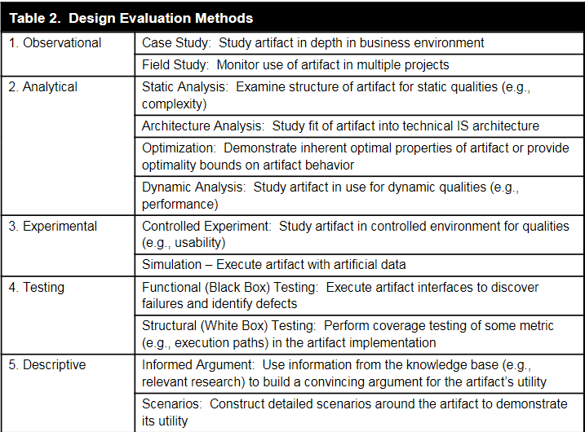

Slide 31
The evaluation of designed artifacts typically uses methodologies available in the knowledge base. These are summarized in Table 2. The selection of evaluation methods must be matched appropriately with the designed artifact and the selected evaluation metrics. For example, descriptive methods of evaluation should only be used for especially innovative artifacts for which other forms of evaluation may not be feasible.

Slide 32
Design as a Search Process
Design science is inherently iterative. The search for the best, or optimal, design is often intractable for realistic information systems problems. Heuristic search strategies produce feasible, good designs that can be implemented in the business environment.
Design is essentially a search process to discover an effective solution to a problem.
Abstraction and representation of appropriate means, ends, and laws are crucial components of design-science research.

Slide 33
Means – Ends - Laws
Means are the set of actions and resources available to construct a solution.
Ends represent goals and constraints on the solution.
Laws are uncontrollable forces in the environment.

Slide 34
Design-science research often simplifies a problem by explicitly representing only a subset of the relevant means, ends, and laws or by decomposing a problem into simpler subproblems. Such simplifications and decompositions may not be realistic enough to have a significant impact on practice but may represent a starting point.

Slide 35
The use of heuristics
The use of heuristics to find good design solutions opens the question of how goodness is measured. Different problem representations may provide varying techniques for measuring how good a solution is. One approach is to prove or demonstrate that a heuristic design solution is always within close proximity of an optimal solution. Another is to compare produced solutions with those constructed by expert human designers for the same problem situation.

Slide 36
Application of the Design Science Research Guidelines
Gavish and Gerdes (1998), which develops techniques for implementing anonymity in Group Decision Support Systems (GDSS) environments
Aalst and Kumar (2003), which proposes a design for an eXchangeable Routing Lan- guage (XRL) to support electronic commerce workflows among trading partners
Markus, Majchrzak, and Gasser (2002), which proposes a design theory for the development of information systems built to support emergent knowledge processes

Slide 37
Discussion and Conclusions
Philosophical debates on how to conduct IS research (e.g., positivism vs. interpretivism) have been the focus of much recent attention (Klein and Myers 1999; Robey 1996; Weber 2003). The major emphasis of such debates lies in the epistemologies of research, the underlying assumption being that of the natural sciences. That is, somewhere some truth exists and somehow that truth can be extracted, explicated, and codified. The behavioral-science paradigm seeks to find what is true. In contrast, the design-science paradigm seeks to create what is effective. While it can be argued that utility relies on truth, the discovery of truth may lag the application of its utility. We argue that both design-science and behavioral-science paradigms are needed to ensure the relevance and effectiveness of IS research. Given the artificial nature of organizations and the information systems that support them, the design-science paradigm can play a significant role in resolving the fundamental dilemmas that have plagued IS research: rigor, relevance, discipline boundaries, behavior, and technology (Lee 2000).

